Slide 1


Presentation Title
TITLE : - Predicting the Compressive Strength of Concrete Using ML Methods

Slide 3


Slide 4

Abstract :-
• To predict the concrete strength of using the composition of its mixture and age of the concrete. Concrete has been widely used in recent years because its production compliments environmental conservation.
• Hence, the focus of this project is the application of machine learning process, and their suitability to predict the concrete strength from its components accurately and then looking for the optimal combination of components which increases the strength.

Slide 5

what will you imagine from the word construction is that mega buildings, machines, materials, etc… but you know that what is used to build these mega buildings?

Slide 6

For construction we use material, cement, iron rods, etc.. where the material is the most important part of building making.
we generally face many real-life problems, like- some social issues, construction, etc.. we can to solve these types of problems using machine-learning techniques

Slide 7






CONCRETE = CEMENT PASTE + INERT MASS
Concrete has been used in :-
Highways and
Streets
Large building
Bridge
Airport
Runways
Irrigation
Structures
Dams

Slide 8
💻 Table of Contents : -
Handling
null
values
Exploratory data
analysis
Importing modules
Reading
data
Study
dataset
Dataset
Dividing independent
and
dependent variables
Predicted values
vs original values
Splitting the
data
Feature scaling
Applying model
Saving
the
model

Slide 9

Problem Statement : -
• In earlier days, the concrete strength is measure through other traditional methods like using drill holes, weight spring, or using sensors. But that requires a significant destruction of test sample and thereby increasing the cost.
• And the accuracy was also hardly 70%.This is generally determined by a standard crushing test on a concrete cylinder. This requires engineers to build small concrete cylinders with different combinations of raw materials and test these cylinders for strength variations with a change in each raw material.
• The recommended wait time for testing the cylinder is 28 days to ensure correct results. This consumes a lot of time and requires a lot of labour to prepare different prototypes and test them. Also, this method is prone to human error and one small mistake can cause the wait time to drastically increase.

Slide 10
Problem Statement : -
•Generally, the one-factor-at-a-time method is used in experimental designs to determine the concrete properties. The major disadvantage of this approach is that it does not consider the interaction between the factors (interaction terms). The higher the number of the controlled and uncontrolled effect variables that influence the concrete properties, the lesser the predicted accuracy.

Slide 11

Objectives : -
• With the use of Machine Learning Model, there will be no limitation of the complexity increasing number of variables. This Model and train and test the given population of concrete and with the best performing machine learning model it can effortlessly predict the strength of the concrete with much higher accuracy than traditional methods.

Slide 12
PREDICTING CONCRETE STRENGTH
Data Collection
Data Preprocessing
Import The Library’s
Importing The Dataset
Data Visualization
Feature Engineering
Feature Scaling
Split The Data In Train And Test
Model Evaluation And Building Model
Web Building Using Flask

Slide 13
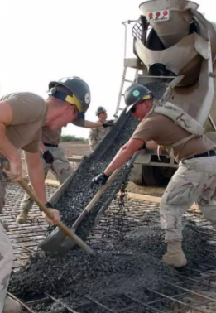
💡Dataset knowledge : -
If you download the dataset, you see that several features affect the quality
of concrete. So we discuss brief of each feature : -
• cement : a substance used for construction that hardens to other materials to bind them together.
• slag: Mixture of metal oxides and silicon dioxide.
• Flyash: coal combustion product that is composed of the particulates that are driven out of coal-fired boilers together with the flue gases.
• Water: It is used to form a thick paste.
• Superplasticizer: used in making high-strength concrete.
• Coaseseaggregate: prices of rocks obtain from ground deposits.
• fineaggregate: the size of aggregate small than 4.75mm.
• age: Rate of gain of strength is faster to start with and the rate gets reduced with age.
• csMPa: Measurement unit of concrete strength.

Slide 14

BASIC COMPONENTS
concrete is the most important man-made material for building. concrete comprises three basic components Water, aggregate, and Portland cement.
To predict the concrete strength of using the composition of its mixture and age of the concrete. Concrete has been widely used in recent years because its production compliments environmental conservation

Slide 15
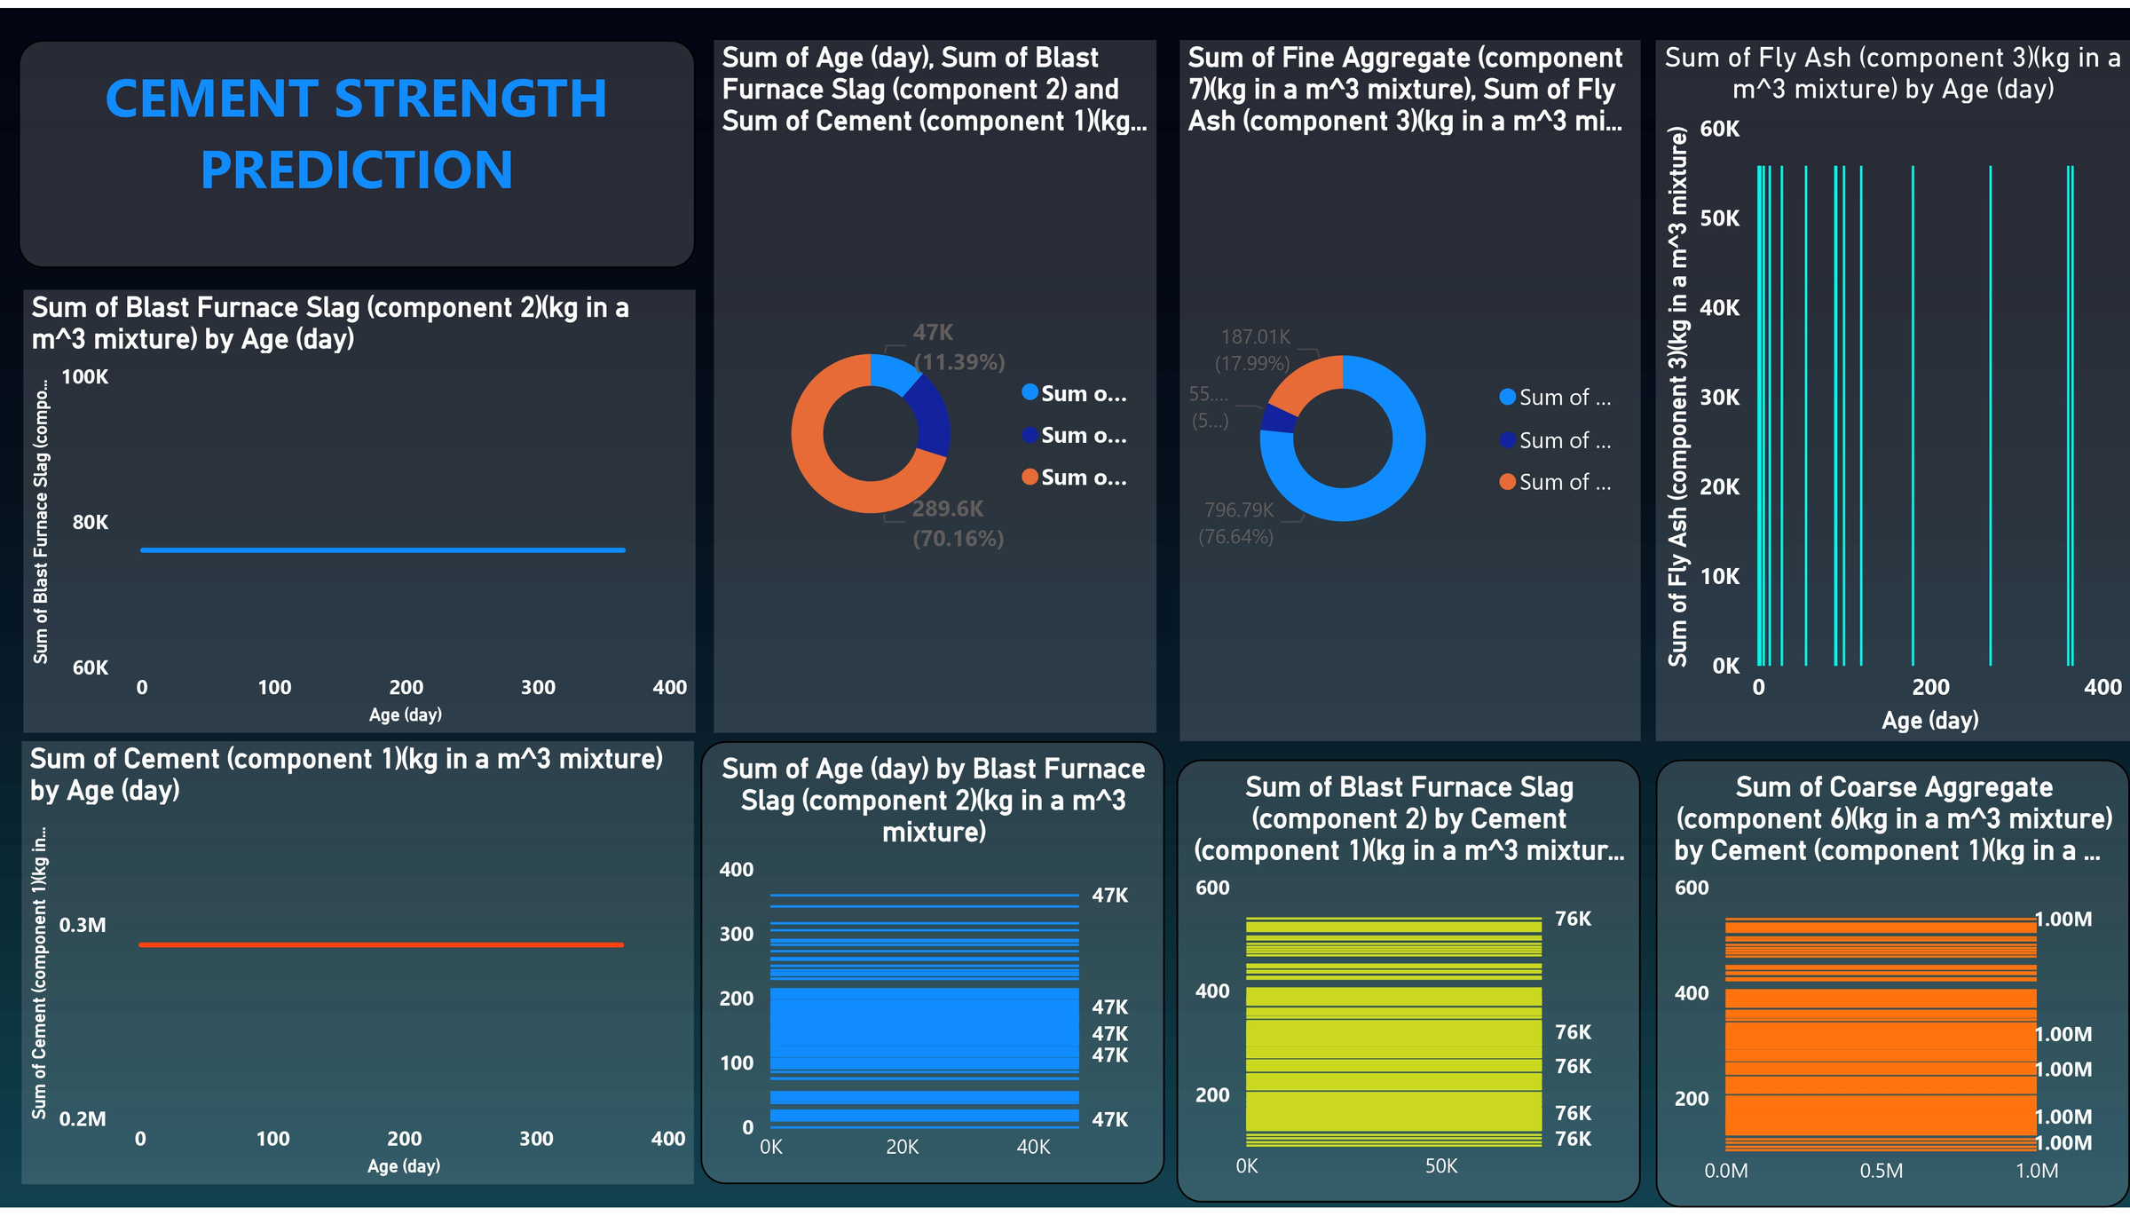

Slide 16
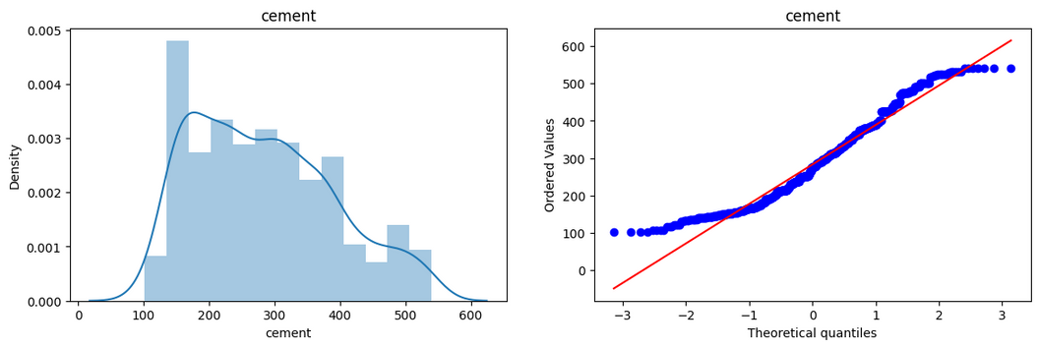
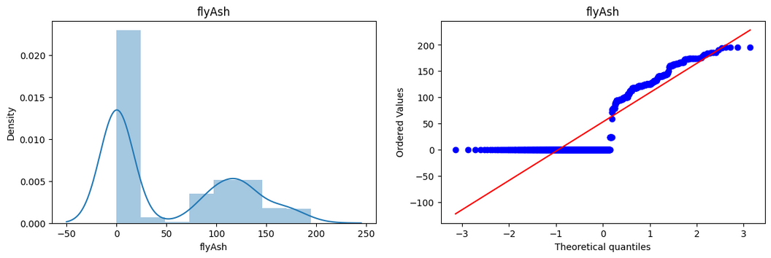
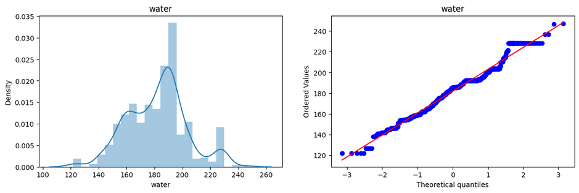
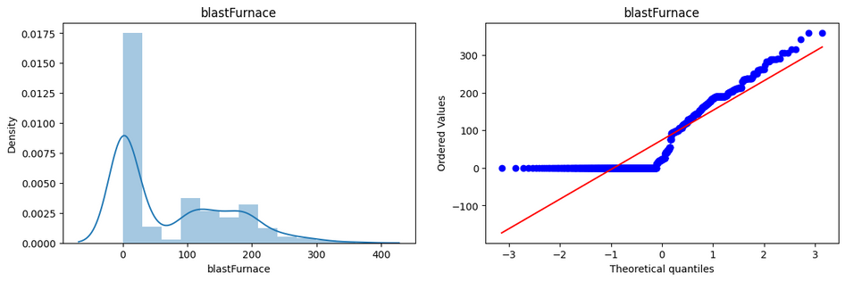
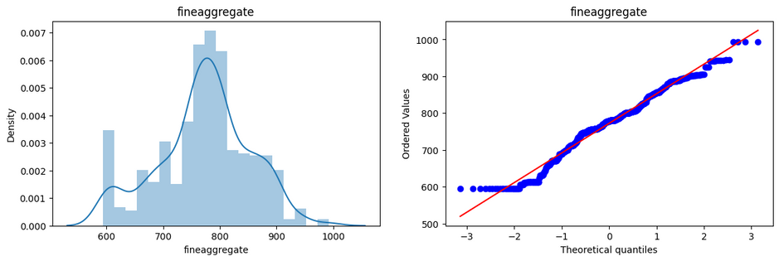
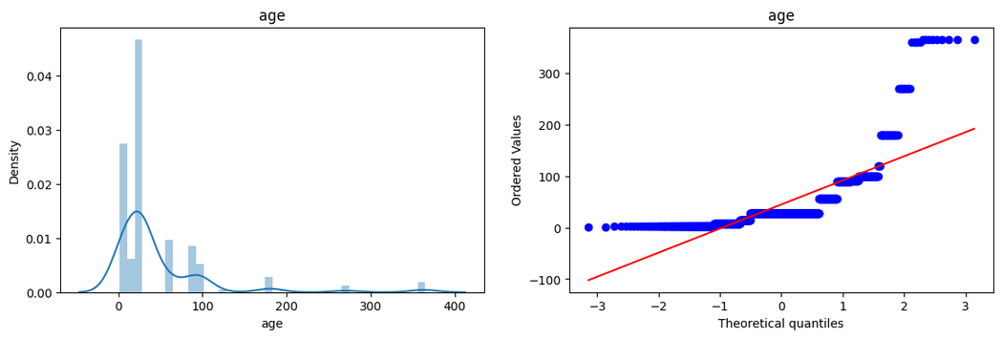
Data Visualization : -

Slide 17
Conclusion : -
• We have analysed the Compressive Strength Data and used Machine Learning to Predict the Compressive Strength of Concrete. We have used xyz algorithm to make predictions and compared their performance.

Slide 18

THANK YOU

